Slide 1
2013/12/26: Mutate L641P in pET29b ACS

Slide 2

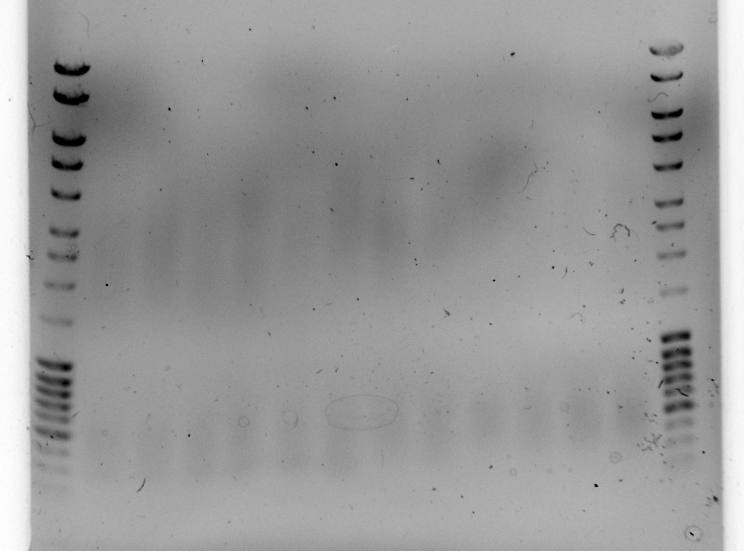
Miniprep DNA first.

Slide 3

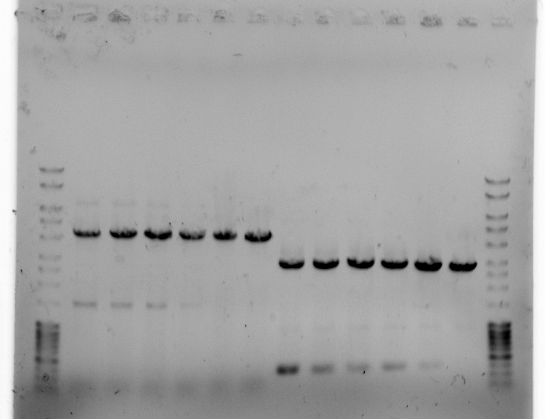
Make 30 uL of well 18 and 30 uL of well 24

Slide 4

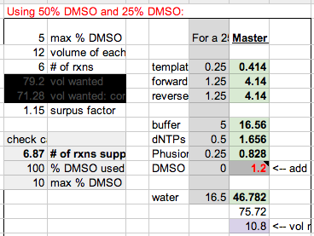
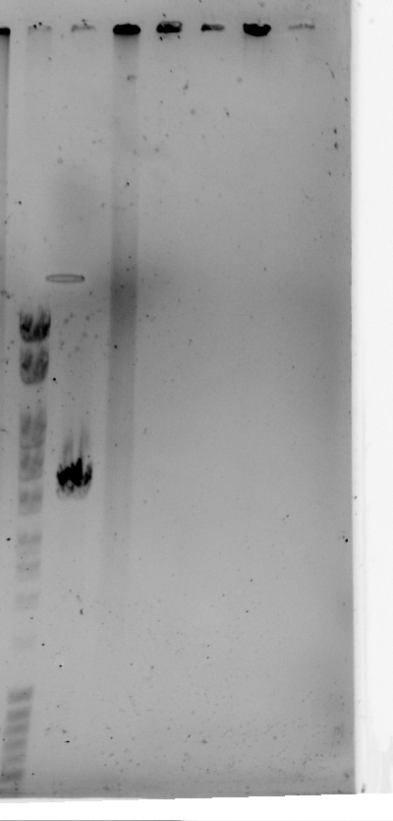
Add ½ uL of Dpn1 to well 25.
Re-do well 26 exactly the same.

Slide 5

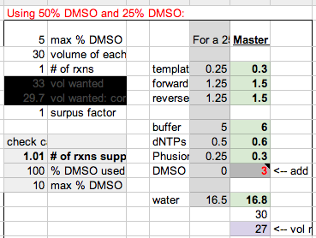


Slide 6

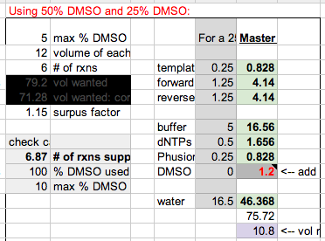
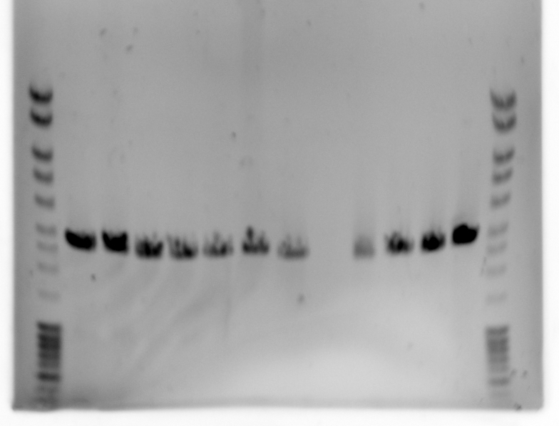

Slide 7

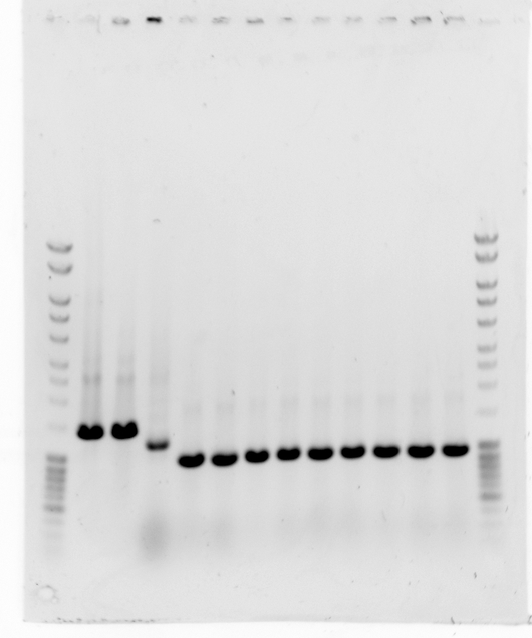
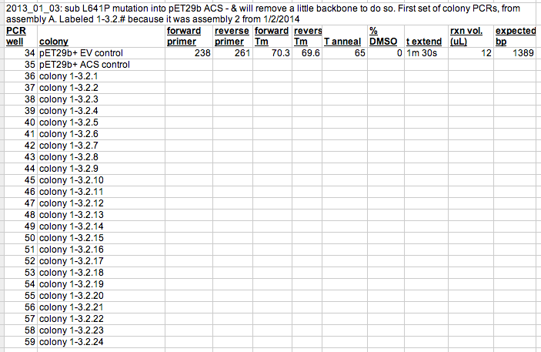
pET29b+ EV
Wells 1-10
pET29b+ ACS

